Slide 1
Educational development software is proud to announce its latest program…
Specifically designed to help Student Assistance Teams!

Slide 2
It is called asap! (which stands for “A student assistance program) …
See what we did there?!?!

Slide 3
You can always learn more at hibreporting.com or by reviewing this presentation for asap highlights!

Slide 4
Ok – here are some highlights!
Completely electronic
Easily adapted to your district’s needs
Designed by educators for educators
Able to send out customized letters to parents
Able to request/compile observations from different staff members
Able to include outside agencies in the development of a plan
Easily integrates with your Student Information System (SIS)
Creates end of year reports as needed

Slide 5
Here are some screenshots of asap!

Slide 6
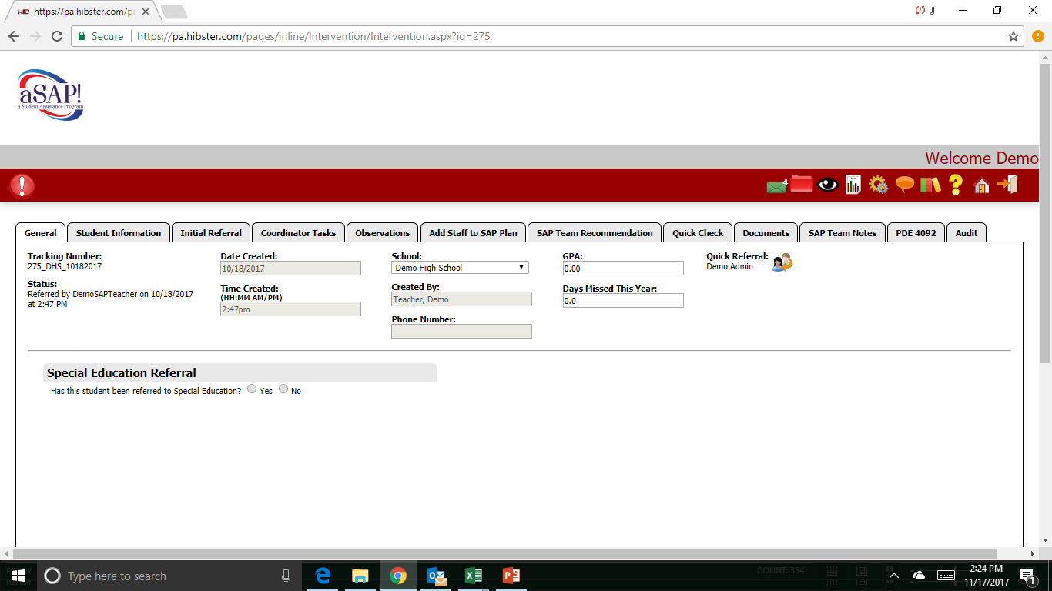

Slide 7
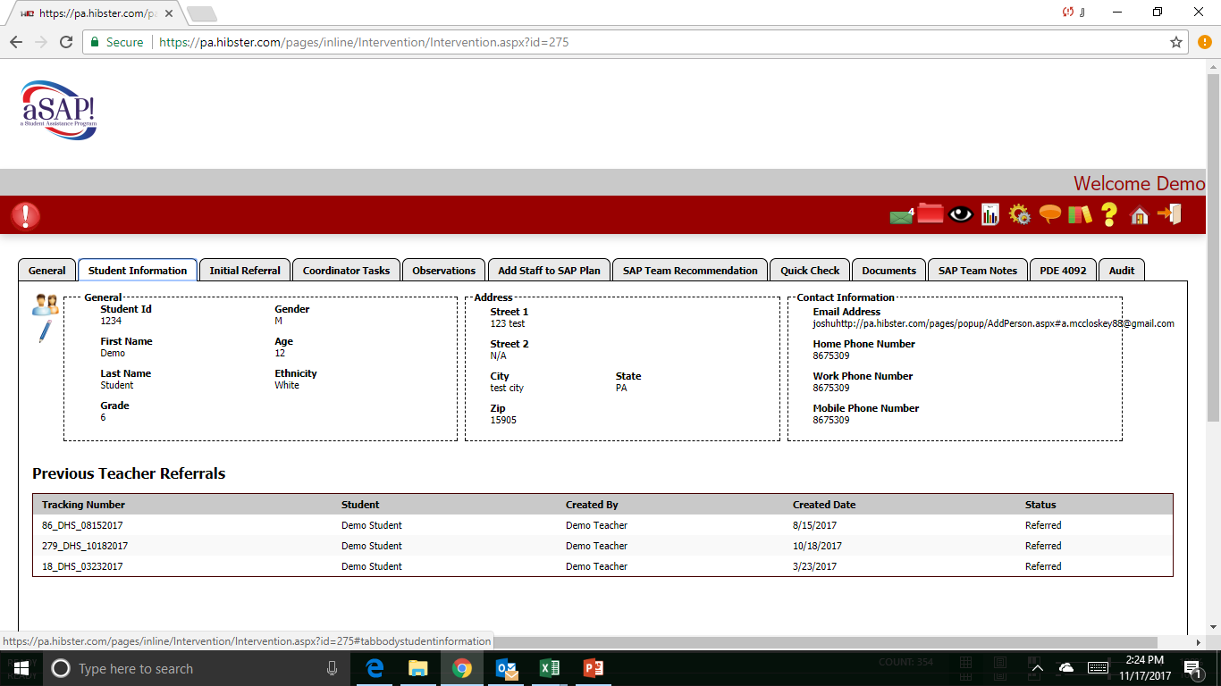

Slide 8
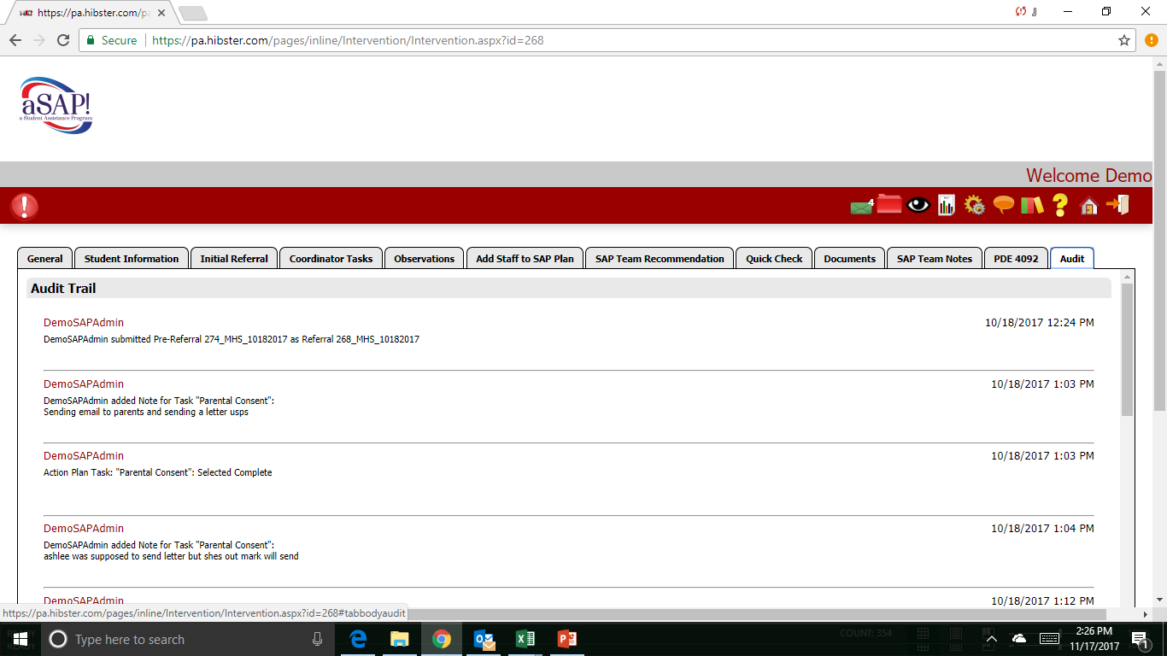

Slide 9
Pretty cool, huh?
There is so much more to the program…
Learn more at hibreporting.com or contact us at sales@hibreporting.com for a 30 minute online demo!

